Slide 1
CdLM in
Politiche per la Sicurezza Globale
LM-52
MAKE THE RIGHT CHOICE

Slide 2
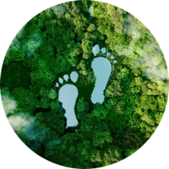
Analizzare le principali sfide alla sicurezza che hanno un impatto sul nostro ambiente socio-politico in rapida evoluzione:
Politiche per la Sicurezza Globale: Ambiente, Energia e Conflitti (English & Italian)
guerra ibrida e cibernetica; terrorismo;
conflitti identitari; proliferazione delle armi di distruzione di massa; pandemie;
migrazioni;
crisi energetiche e cambiamenti climatici

Slide 3
2 CURRICULA
CONFLITTI E SICUREZZA NEL MONDO GLOBALE
Giurisidizioni Internazionali
Storia del Terrorismo
Teoria dei Diritti Umani
AMBIENTE, ENERGIA E SICUREZZA GLOBALE
Diritto Europeo dell'Ambiente
History and Politics of Energy Teorie dei Diritti Umani
Studi Strategici
International History of Peace
Economia e Politica dello Sviluppo
Energy Economics and Climate Change Policy
Statistica Ambientale
Sustainability, Economic Development, and Transport
Storia della Politica Internazionale Contemporanea
Teorie dei Conflitti e Processi di Pace
Geopolitica dell'Energia e dell'Ambiente
The EU in Global Environmental Governance

Slide 4
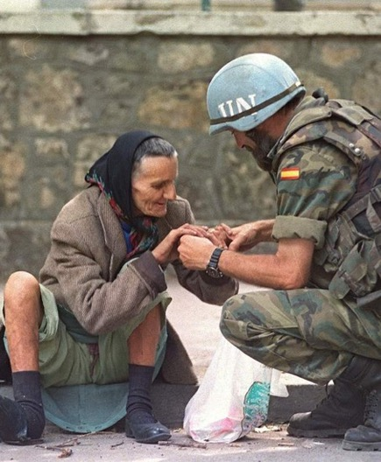
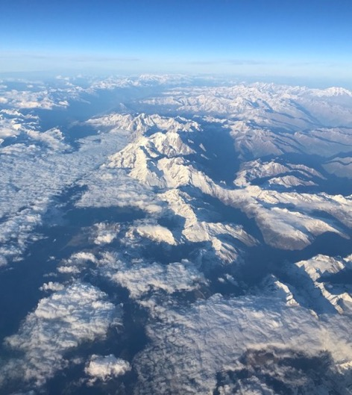
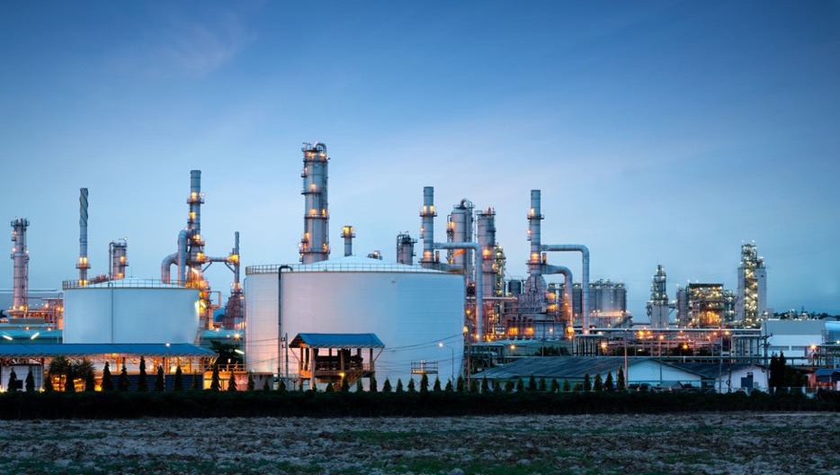
MA Programme in Global Security Studies: Environment, Energy, and Conflicts
Path A: Conflicts and Security in the Global World
Path B: Environment, Energy, and International Security

Slide 5
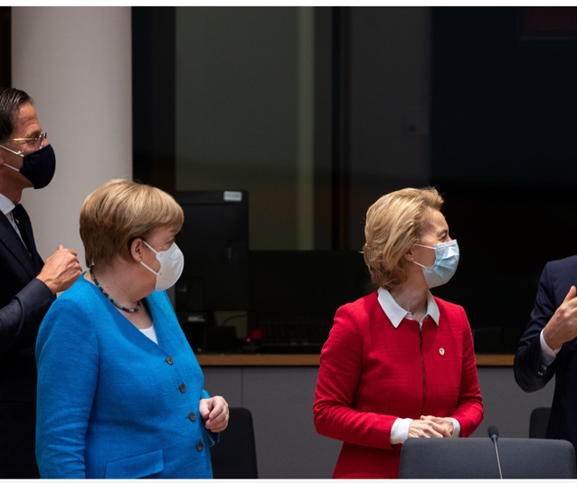
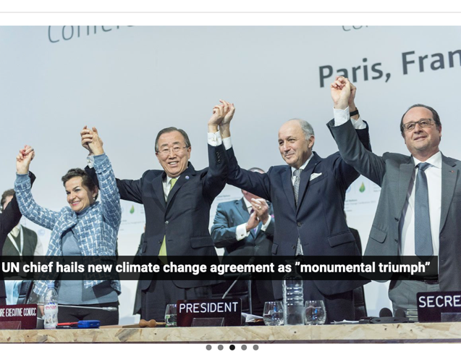
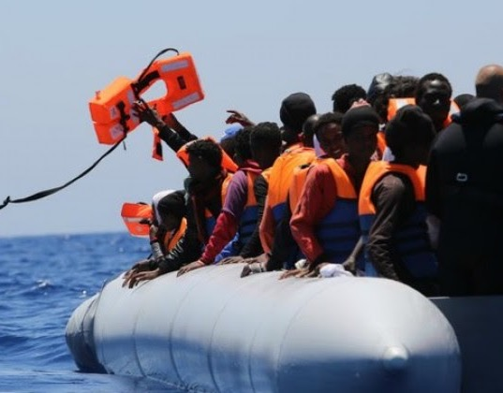
MA Programme in Global Security Studies: Environment, Energy, and Conflicts
The Master’s Degree Programme in Global Security Studies (GSS) provides students with the skills to analyse the main challenges to security which have an impact on our social and political environment that is rapidly evolving on a global, national, and local level. Therefore, the GSS programme analyses new types of hybrid and cybernetic wars, terrorism, identity conflicts, the proliferation of weapons of mass destruction, pandemics, migrations, energy crisis, and climate change.

Slide 6
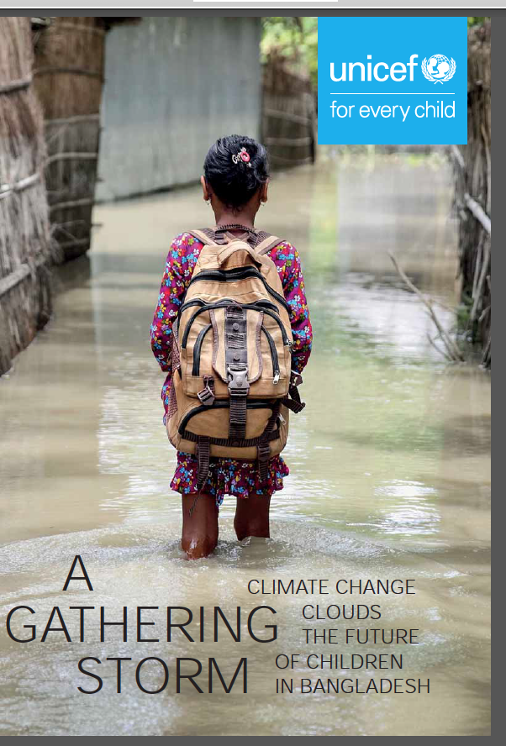
Climate Security
According to Kirsty Lewis, “Climate security is the study of the impact of climate and climate change on the security of affected communities.” Climate change intersects a broad spectrum of security notions: it has come to be considered as both a threat in itself and a multiplier of other issues/challenges, different forms of competition, armed conflicts which stem from the scarcity of clean water, soil or food and get worse due to this phenomenon. Climate security reinforces or challenges other security agendas. In the 1980s and 1990s climate was not yet a security issue, however it was already becoming a challenge to economic security and energy security.

