Slide 1
M A P R O G R A M M E I N
INTERNATIONAL STUDIES
OPENING POSSIBILITIES

Slide 2
EDUCATIONAL AND PROFESSIONAL OBJECTIVES
The Master of Arts in International Studies (MAIS) provides students with the tools to understand and operate in the international environment. The teaching method ensures that students are constantly engaged in the classroom, where they can experience different approaches to the study and analysis of key international dynamics and challenges. The MAIS degree opens up career opportunities in diplomacy, both at the national and at the international level, NGOs, corporations and think tanks.

Slide 3
MAIS KEY TOPICS
THEORY OF INTERNATIONAL RELATIONS
HISTORY OF INTERNATIONAL RELATIONS
INTERNATIONAL LAW
MACROECONOMIC MODELS

Slide 4
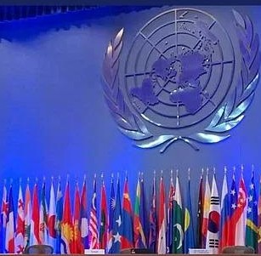
MAIS KEY TOPICS
THEORY OF HUMAN RIGHTS
GLOBALISATION PROCESSES
PEACEKEEPING & COOPERATION
REGIONAL INSTITUTIONS & POLITICS

Slide 5
HOW MAIS WORKS
2 FREE-CHOICE COURSES
ARABIC STUDIES CHINESE STUDIES
GLOBAL ECONOMY AND LABOUR RIGHTS
HISTORY AND POLITICS OF MIDDLE EAST AND NORTH AFRICA
HISTORY OF MIGRATION REPRESENTATIVE INSTITUTIONS IN EUROPE: HISTORY AND THEORIES THE EU IN GLOBAL ENVIRONMENTAL GOVERNANCE
3 ELECTIVE COURSES
EAST ASIAN HISTORY IN THE CONTEMPORARY WORLD EUROPEAN CONSTITUTIONAL LAW EVOLVING SECURITY IN THE POST 1945 WORLD
GENDER & POLITICAL THEORIES MULTICULTURAL AMERICAN LITERATURE
SUSTAINABILITY, ECONOMIC DEVELOPMENT, AND TRANSPORT THE ROOTS OF GLOBALIZATION: EUROPEAN EXPANSION AND COLONIALISM
8 MANDATORY COURSES
INTERNATIONAL LAW & DEVELOPMENT IINTERNATIONAL HISTORY OF PEACE INTERNATIONAL MACROECONOMICS NTERNATIONAL POLITICS
THE INTERNATIONAL SYSTEM AFTER THE END OF THE COLD WAR THEORY OF HUMAN RIGHTS
THE UNITED STATES AND THE WORLD IN THE 20TH AND 21ST C. FRENCH/GERMAN/RUSSIAN/SPANISH

Slide 6
INTERNSHIP OPPORTUNITIES
Some international organisations offer paid
internships as part of recruitment programmes.
their These
university internships
are open to all students. Sometimes a selective process is required for specific calls.

Slide 7
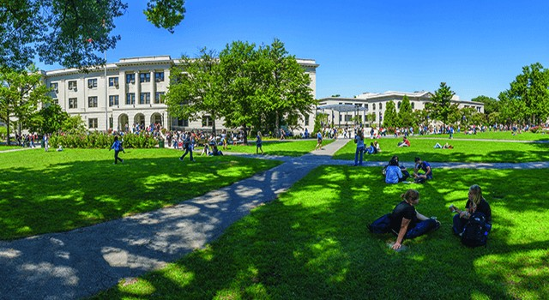
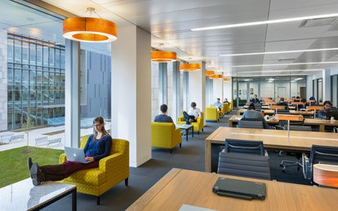
INTERNATIONAL ACCELERATED DEGREE PROGRAMME

Slide 8
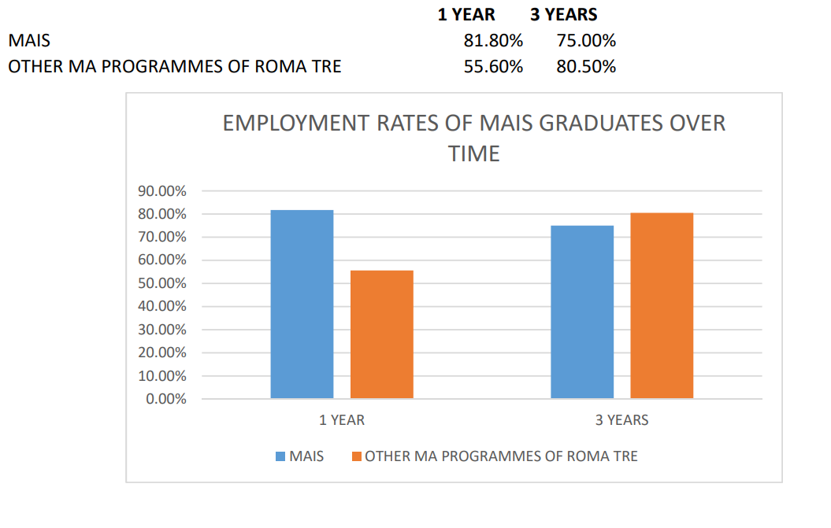
Graduates' Employment Status

Slide 9
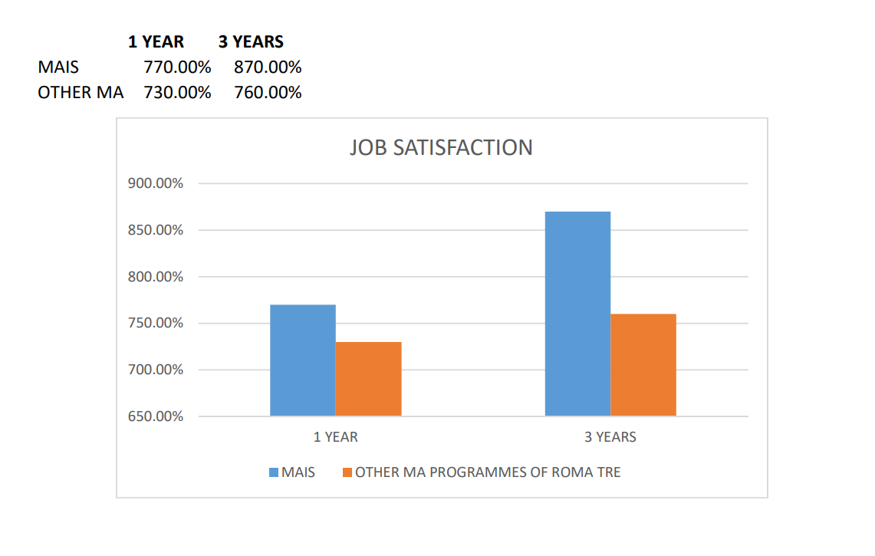
Graduates' Employment Status

Slide 10
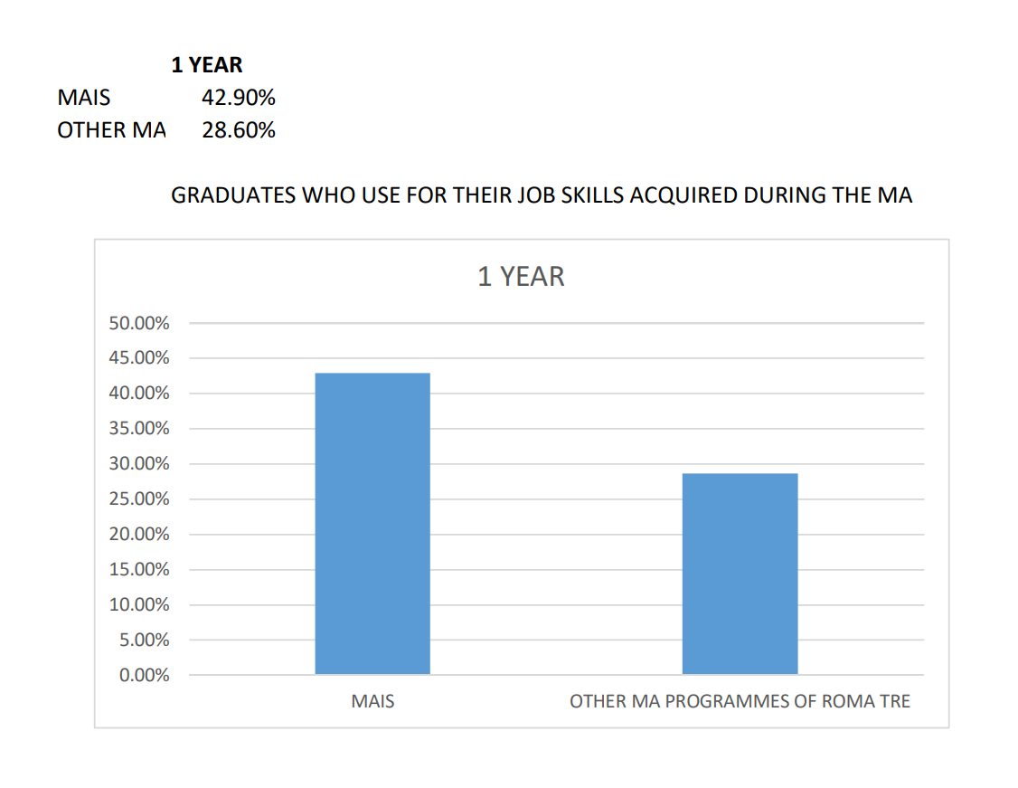
Graduates' Employment Status

Slide 11
How to Be Eligible
Maintain at least a GPA of B throughout your undergraduate studies.
Successfully finish at least 1 Course (6 ECTS) in: Political Science/International Relations/Sociology History
Economics Law
Proficiency in 2 Foreign Languages (English is Mandatory - B2 Level according to the CEFR).
You Can Apply Even if You Graduate in the Next Months After the Application (Enrolment Deadline = Beginning of September - Late Enrolment with a Fee = Beginning of December - Graduation = within the End of March)

Slide 12
Scholarships, VISA, and Residence Permit
Apply for :
Scholarships and other benefits = It is possible to apply for a scholarship and housing through the Regional Institution for Study Rights Lazio Disco.
Those applicants who aren't eligible for a scholarship or students that could not apply within the deadline, can still ask for a reduction of the university fees according to the information available on Roma Tre website (Tuition Fees).
VISA (only for non-EU students) = Register on the Universitaly platform that enables students to both apply to the University and to request a visa for study purposes.
Residence Permit (only for non-EU students) = No later than 8 days after arriving in Italy, students must apply for a residence permit for study reasons at the local Police Headquarters. The application can also be submitted at the Post Office, by filling out the relative application forms. Several agencies and qualified charitable institutions may also provide assistance with regard to the submission of the forms.
Upon application, the student shall be identified and asked to pay a fee for the residence permit issuing procedure, which amounts to a total of approximately 107.50 Euros. For further info on this subject, please see Study in Italy.

Slide 13
In Case of Remedial Courses/Single Units
Pay attention to the deadlines (Enrolment and Payment)
All the remedial courses taken at Roma Tre are fully refunded after your enrolment in the MAIS.
It is mandatory to pass the final exams within the Fall Semester (January/February) or you are not eligible for admission.
A minimum passing grade of 18/30 is required (Remedial Courses Do Not Count toward the MA Degree).

Slide 14
From Enrolment to Graduation
Offices of Reference during the Pre-Enrolment
CULM (for didactic matters) & Roma Tre Office for Students with International Degree (for administrative procedures and Universitaly) are in charge of supporting students from the pre-enrolment stage right up to enrolment.
Offices of Reference after the Enrolment
After enrolment, students shall basically refer to:
Roma Tre Student Office for bureaucratic/administrative procedures; the Department of Political Science and CULM for didactic matters

Slide 15
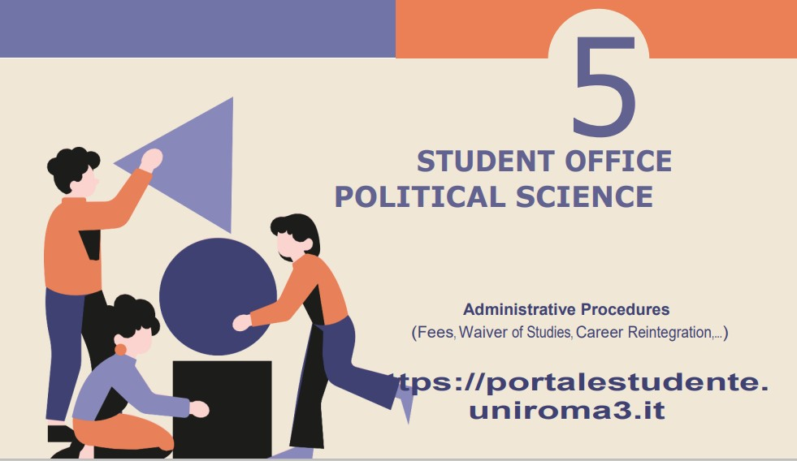

Slide 16
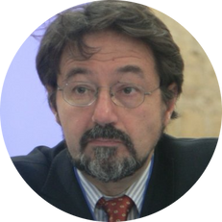
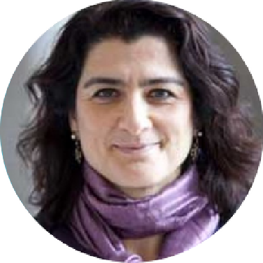
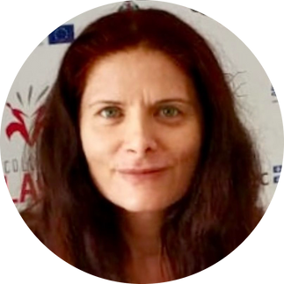
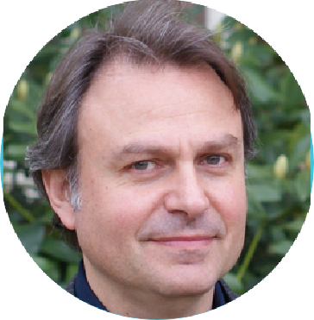
WHO IS WHO
PROF. LEOPOLDO NUTI
Academic Committee Coordinator leopoldo.nuti@uniroma3.it
PROF. MARILENA GALA
MA Programme Coordinator marilena.gala@uniroma3.it
DR. LEILA TAVI
MA Programme Officer rise.sp@uniroma3.it
PROF. FRANCESCO MAIOLO
MA Programme Tutor francesco.maiolo@uniroma3.it

Slide 17
THANK YOU FOR YOUR TIME
ANY QUESTIONS?

